Slide 1
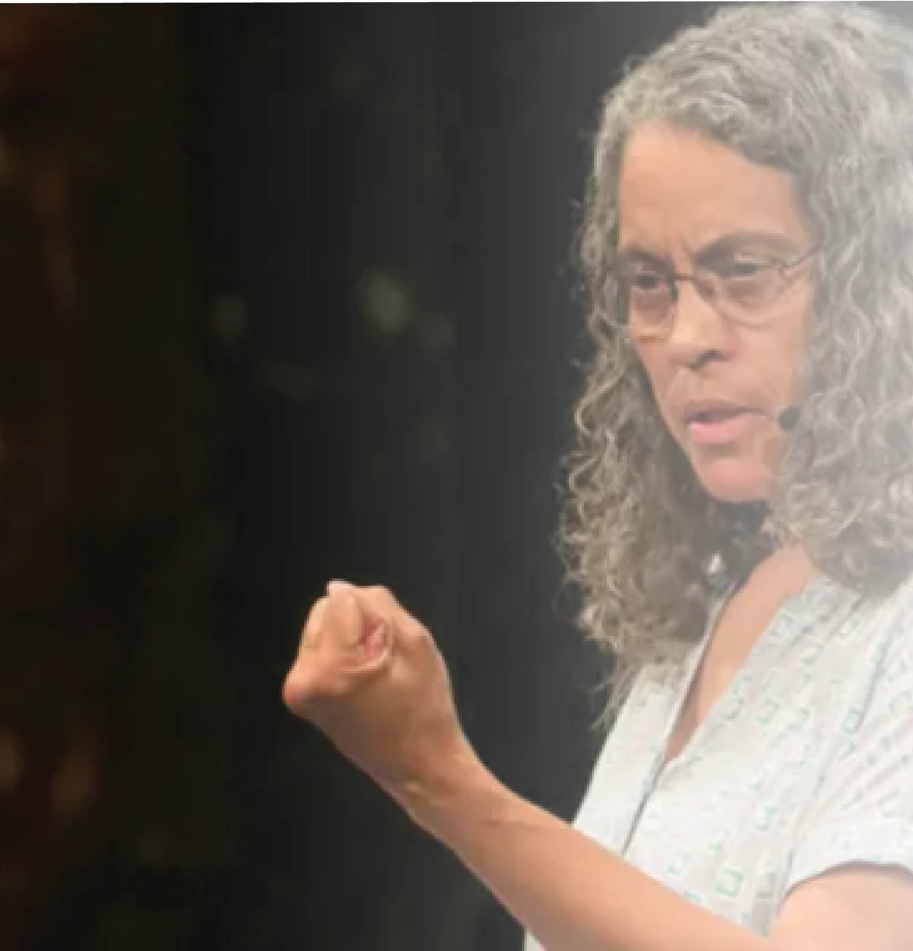
^{The Graduate Center, CUNY’s}
Environmental Psychology Program welcomes,
^{Mindy Fullilove, MD}
^{400 YEARS AMERICAN}
^{INEQUALITY}
^{presenting}
^{OF}
^{Wednesday, February 20, 2019}
^{Rm. 6304.01 11:45-2p}
^{during Brown Bag with}
^{informal Q&A and discussion}

