Slide 1
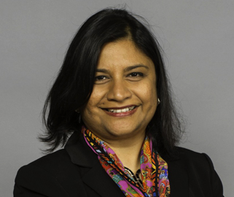
Critical Social/Personality & Environmental Psychology
Brown Bag Lecture Series, Fall 2018
Laxmi Ramasubramanian, PhD
Pragmatic, Participatory, and Political: Successful Policy Implementation Using E-B Research
Wednesday, November 7, 2018 11:45am, Room 6304.01

